Slide 1
Resume Screening & Classification
Project on Machine Learning
By:
Atharva Kale-1132220912
Sumedh Tardalkar-1132220959

Slide 2
Index
Introduction
Software & Hardware Requirements
Architecture
Graphs & Tables
Model Building
Accuracy Interpretation
Results
Bibliography
Conclusion

Slide 3
Introduction
In today's tech-driven era, manual resume sorting is obsolete. Machine Learning streamlines the process, swiftly organizing resumes by job roles.
ML efficiently processes resumes, pinpointing crucial details like skills and work experience.
Our project aims to develop a precise ML model for screening and classifying resumes based on job roles.
We use RFC/SVC, supervised learning algorithms, to analyze a diverse dataset of resumes and associated job roles.

Slide 4
Problem Statement
In the competitive job market, manual resume screening poses inefficiencies, biases, and risks of overlooking qualified candidates.
Prompting the need for an automated solution utilizing supervised learning to swiftly identify the most suitable resumes and ensure the quality of recruited talent.

Slide 5
Hardware &
Software Requirements
Software Requirements
Python 3.8/3.9
Vscode
Hardware Requirements
Windows/ Macos
8 GB Ram

Slide 6
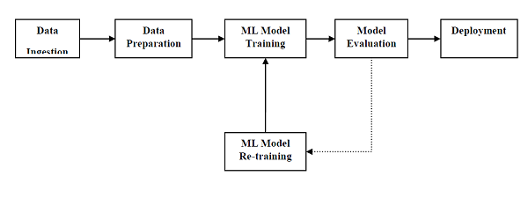
Architecture

Slide 7
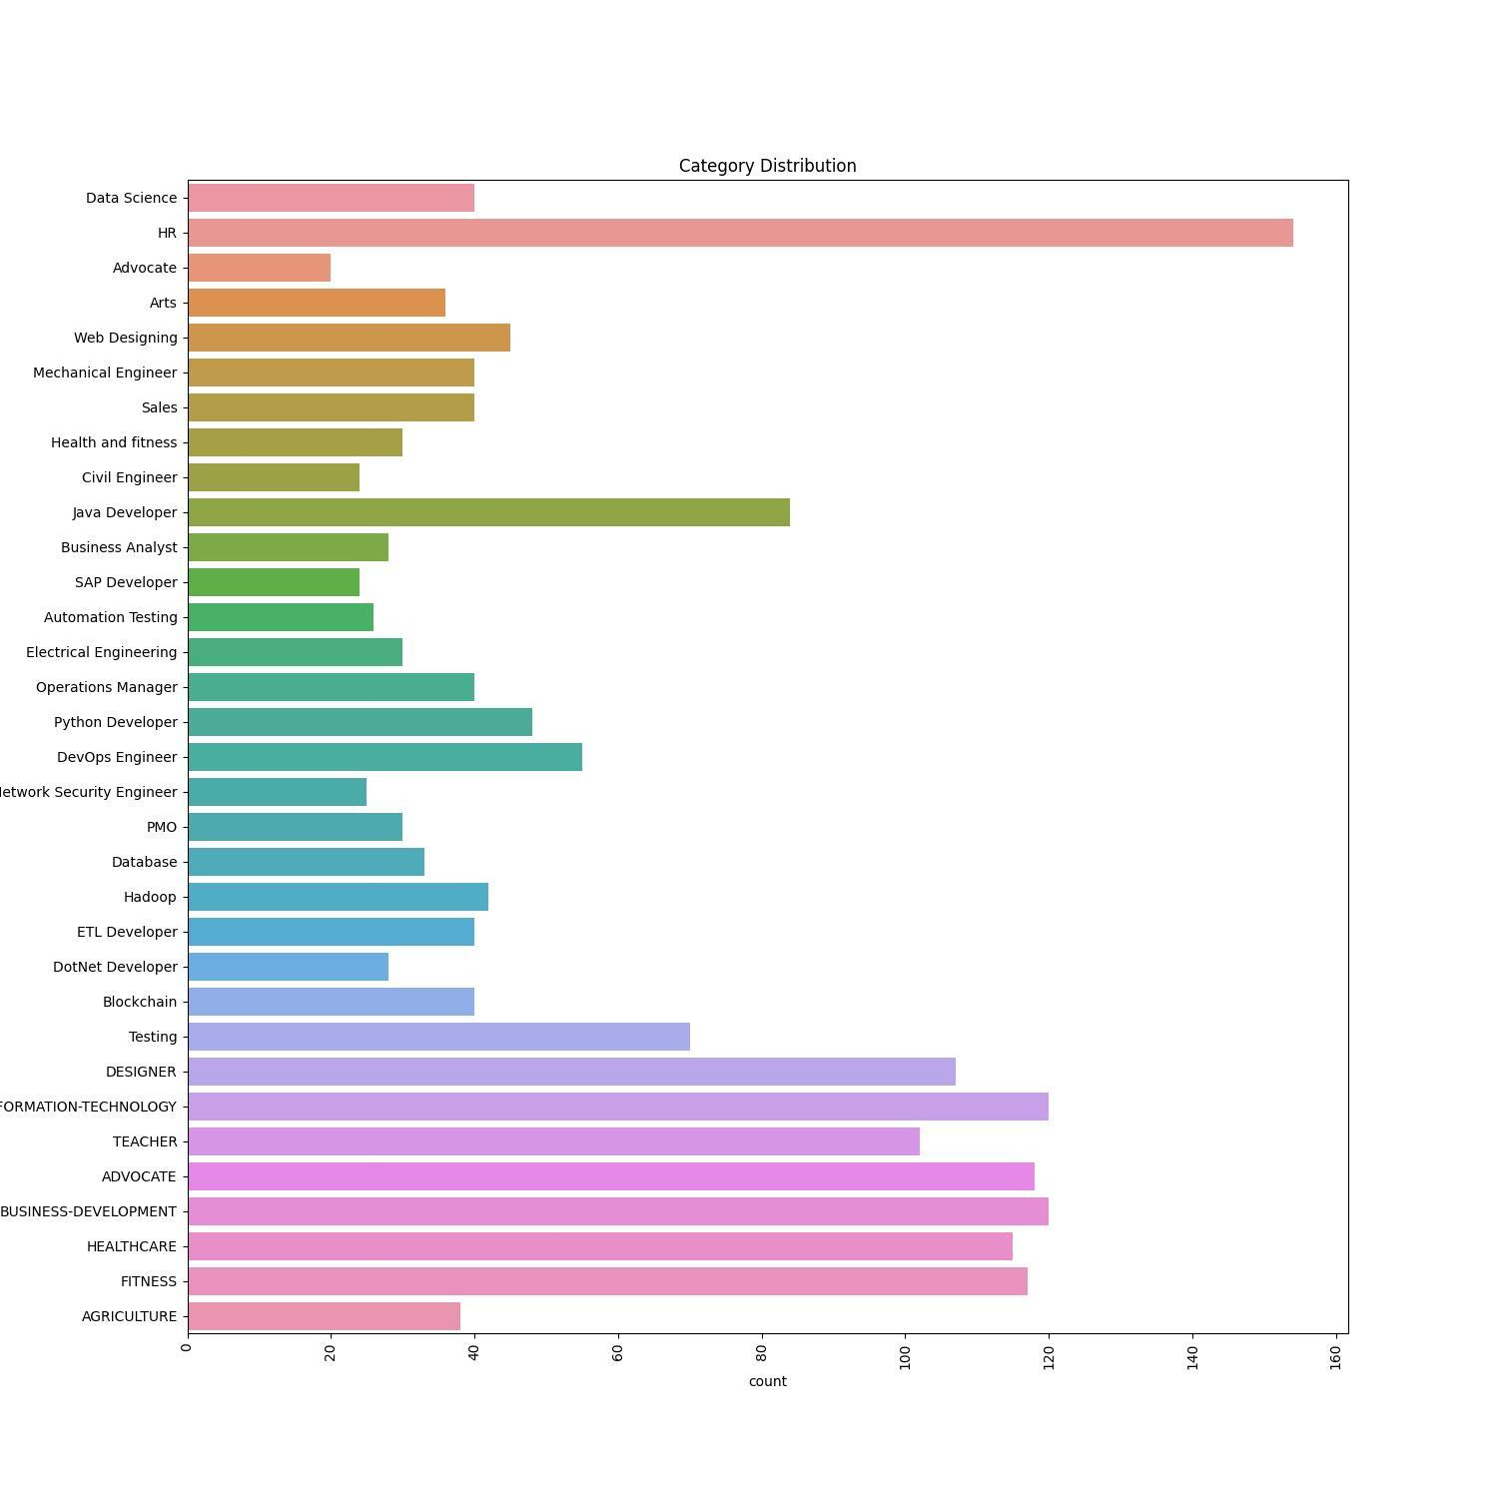
Graphs
The above image shows the bar plot of the data frame of the input dataset.
X-axis:Count Y-Axis:Category Of Resume
This plot gives the general distribution of data and describes the dataset and how the data taken is distributed over different categories.
This distribution gives the total size of the dataset.

Slide 8
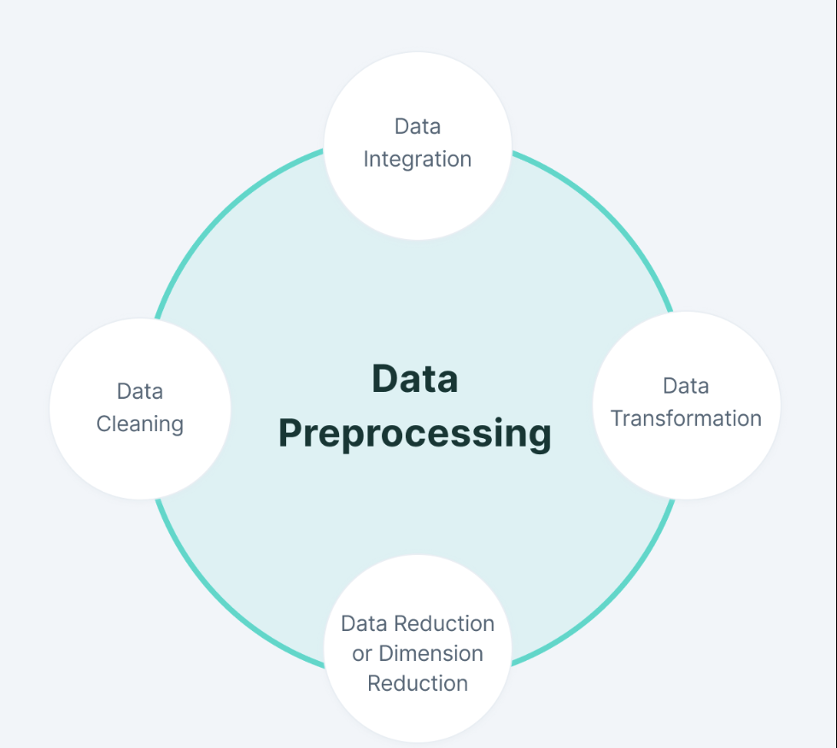
DATA PRE-PROCESSING

Slide 9
MODEL SELECTION
1. Model selection is crucial in machine learning, impacting a model's performance significantly.
2. To prevent overfitting, model selection ensures a balanced fit to both training and validation data.
3. Enhancing model accuracy is a key outcome of effective model selection.
4. Model selection also minimizes computational costs by opting for models with fewer parameters.

Slide 10
Model Building
Here the Dataset is downloaded or data extraction process is carried out. For eg, data is collected through web scraping using beautifulsoup.
Data Ingestion
This is the step where all the data collected is checked thoroughly for outliers, null values & data is converted into normalized form before feeding the data to model
Data Pre-Processing
Model Selection & Training
Here ML models are selected or are custom made according to the
Results Proessing
rr

Slide 11
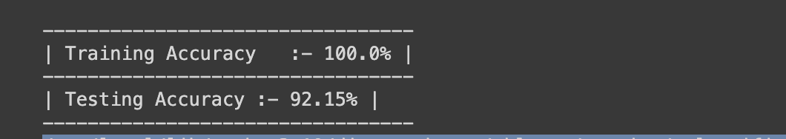
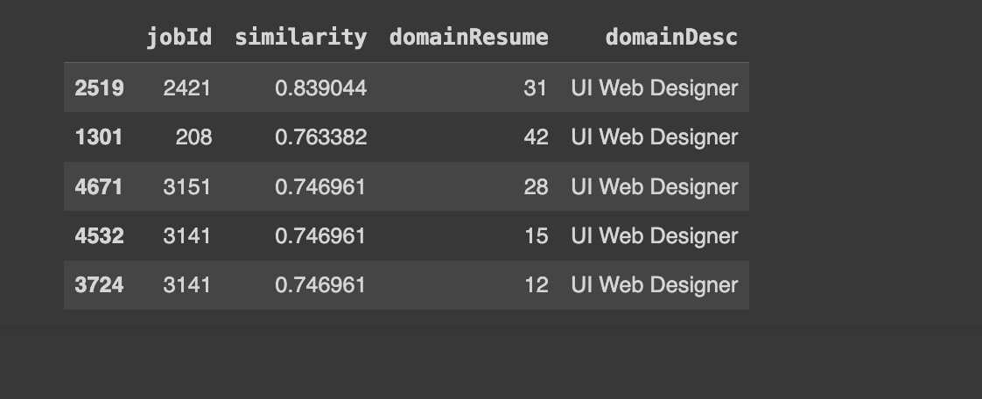
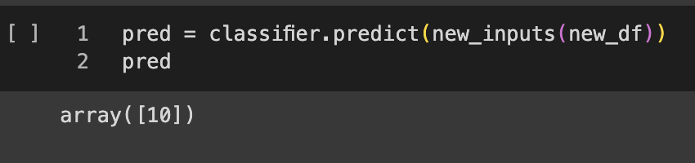
Results & Discussion
Project Link
Results of RFC
Predication Results of a new resume and it gives categorical value of the resume to which it belongs.
https://colab.research.google.com/drive/1AoTdazFFxLak37zlGulMagn0vm0rJebB#scrollTo=QCD-7FjkDjOQ

Slide 12
Similarity Of a Resume classified in Prev Program

Slide 13
Conclusion
While the presented approach has demonstrated positive outcomes, there are still unexplored avenues for further exploration. One significant area is the advancement of more intricate machine learning algorithms capable of better grasping the intricacies of human language and the complexity of resumes.
Additionally, developing methods to integrate additional data sources like social media profiles and online portfolios into the resume screening process is crucial.
Finally, it is essential to establish methods for evaluating the fairness and impartiality of machine learning models for resume screening.

Slide 14
Bibliography
Lu, J., Wu, D., Mao, M., Wang, W., Zhang, G., 2015. Recommender system application developments: a survey. Decision Support Systems 74, 12–32
Boudreau, J. W., & Ramstad, J. M. (1996). Spotting winners: The art of recruiting and hiring the right people. Chicago: McGraw-Hill.
Erickson, T. D., Lamoureux, J. E., & Moulton, C. K. (2014). The impact of hiring quality on organizational outcomes. Journal of Applied Psychology, 99(8), 1081-1095.)
Lawler III, E. E. (2007). Total quality management in human resource management. In R. I. Sutton (Ed.), Handbook of organizational management (pp. 191-230). London: Sage Publications.
Automated Resume Screening: A Review of the Literature" by Mohammadreza Asadi, et al. (2021) This paper provides a comprehensive overview of the state-of-the-art in automated resume screening (ARS). The authors discuss the different approaches to ARS, the factors that affect the performance of ARS systems, and the challenges and limitations of ARS.
"Deep Learning for Resume Screening: A Survey" by Yi Zhang, et al. (2021) This paper surveys the use of deep learning for resume screening. The authors discuss the different deep learning architectures that have been used for this task, and the performance of these architectures on different benchmark datasets.
"Towards Fair and Explainable Resume Screening" by Daniel G. Taylor, et al. (2020) This paper discusses the challenges of fairness and explainability in resume screening. The authors propose a framework for developing fair and explainable resume screening systems.
"A Review of Resume Parsing and Classification Techniques" by Manish Kumar Singh, et al. (2020) This paper reviews the different techniques that have been used for resume parsing and classification. The authors discuss the advantages and disadvantages of each technique.
"Automated Resume Screening: A Systematic Literature Review and Meta-Analysis" by Eleni Vasilescu, et al. (2019) This paper conducts a systematic literature review and meta-analysis of automated resume screening (ARS) studies. The authors identify the most common ARS techniques, and the factors that affect the performance of ARS systems.

